Slide 1

Style Change Detection
Text Mining Project 2020
Anthony Odinukwe
odinuk02@ads.uni-passau.de
University of Passau
Shine Jose
jose01@ads.uni-passau.de
University of Passau
Subin Sam Varghese
samvar01@ads.uni-passau.de
University of Passau

Slide 2
Overview
Motivation & Problem statement
Data Analysis
Methodology
Performance Evaluation
References

Slide 3
Motivation
In the event PAN2020, The style change detection task is to identify text positions within a given multi author document at which the author switches.
• For the given document is written by multiple authors?
• For each pair of consecutive paragraphs in the given document:
is there a style change between these paragraphs?

Slide 4
Problem Definition
To use Machine learning algorithms to achieve given below tasks,
From the given document is written by a single person from his writing style by extracting features from the content of documents.
For a Multi-Authored document we try to predict the exact paragraph where the style change has occurred.

Slide 5
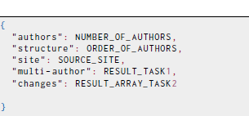
Data Analysis
How did the dataset looks like?
Problem-X.txt contains the document X
Truth Problem-X.json contains the labels for document X

Slide 6
Data Analysis
Which labels are used?
Task1 the label used is Multiple Author
Task2 the label used is changes

Slide 7
Feature Extraction
The features used in this project can be categories as follows:
Features based on Sentence structure
Features based on Words structure
Features based on Stop Words
Readability Index

Slide 8
Methodology-Task 1
Models are trained using the Training Dataset using K-fold method and then predict the output on validation data.
What does simple Baseline model say?
The baseline is probability of predicting the target classes randomly.
The baseline model gives a minimum threshold accuracy of multiple author prediction.
Is there a better Model?
Among different machine learning algorithms used LightBGM performed best in both training and validation data.

Slide 9
Methodology Task 2
Two Approaches for Task2:
Kmeans Clustering based on ClustDist Method
Clustering based on Hierarchical Cluster Analysis.

Slide 10
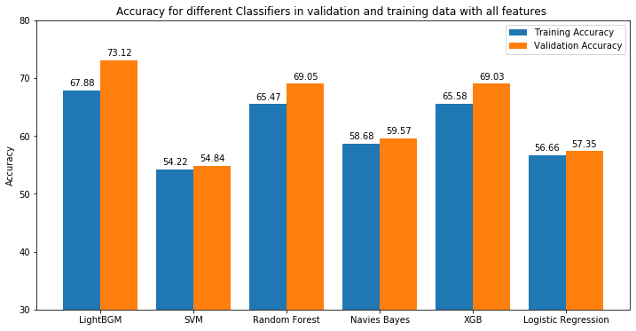
Performance Evaluation
Visualize Results for task 1, Obtained

Slide 11
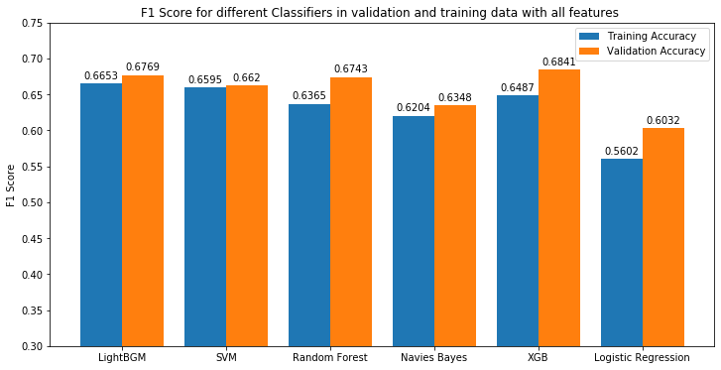
Results

Slide 12
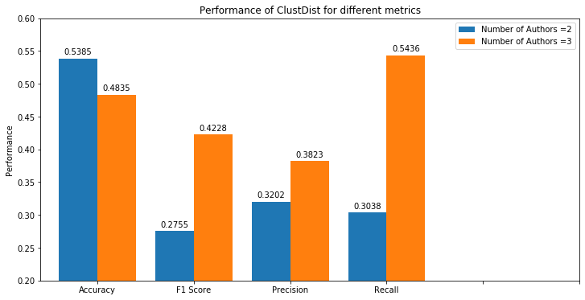
Results
Visualizing Results For Task 2, Obtained

Slide 13
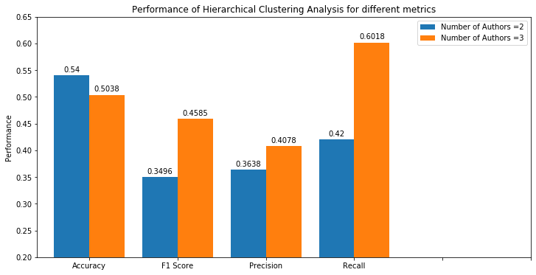
Results

Slide 14
Results Summarized
The LightBGM algorithm performed best with Accuracy and F1 score. Obtained from the given data set is, 67.88 in the Training Data set and 73.12 in the Validation Data Set for accuracy and F1 score is 0.6653 in Training Data Set and Validation set 0.6769 is obtained.
Accuracy and F1 score obtained from the given data set is, 52.46 for accuracy and 0.4044 for mean F1-Score in Hierarchical Clustering Analysis(HCA) method while in Clust-Dist 51.08 for Accuracy and 03497 for F1-Score.

Slide 15
References
Michael Gamon. 2004. Sentiment classification on customer feedback data: noisy data, large feature vectors, and the role of linguistic analysis. In COLING 2004: Proceedings of the 20th International Conference on Computational Linguistics. 841–847.
Helena Gómez-Adorno, Carolina Martín-Del-Campo-Rodríguez, Grigori Sidorov,Yuridiana Alemán, Darnes Vilariño, and David Pinto. 2018. Hierarchical clustering analysis: the best-performing approach at PAN 2017 author clustering task. International Conference of the Cross-Language Evaluation Forum for European Languages. Springer, 216–223.
Mikhail P Kuznetsov, Anastasia Motrenko, Rita Kuznetsova, and Vadim V Strijov.2016. Methods for Intrinsic Plagiarism Detection and Author Diarization.. In CLEF (Working Notes). 912–919.
Peter Müller. 2019. Style Change Detection.
Ifrah Pervaz, Iqra Ameer, Abdul Sittar,and Rao Muhammad Adeel Nawab. 2015.Identification of Author Personality Traits using Stylistic Features:Notebook for AN at CLEF 2015...

Slide 16
References
Abdul Sittar, Hafiz Rizwan Iqbal, and Rao Muhammad Adeel Nawab. 2016. Author
Diarization Using Cluster-Distance Approach.. In CLEF (Working Notes). 1000–1007.
Efstathios Stamatatos. 2009. Intrinsic plagiarism detection using character n-gram
profiles. threshold 2, 1,500 (2009).
Eva Zangerle, Maximilian Mayerl, Michael Tschuggnall, Günther Specht, Martin
Potthast, and Benno Stein. 2020. PAN20 Authorship Analysis: Style Change Detection. https://doi.org/10.5281/zenodo.3660984
Dimitrina Zlatkova, Daniel Kopev, Kristiyan Mitov, Atanas Atanasov, Momchil
Hardalov, Ivan Koychev, and Preslav Nakov. 2018. An ensemble-rich multi-aspect
approach for robust style change detection. CLEF 2018 Working Nots of CLEF
(2018).

Slide 17
Thank You

